Slide 1
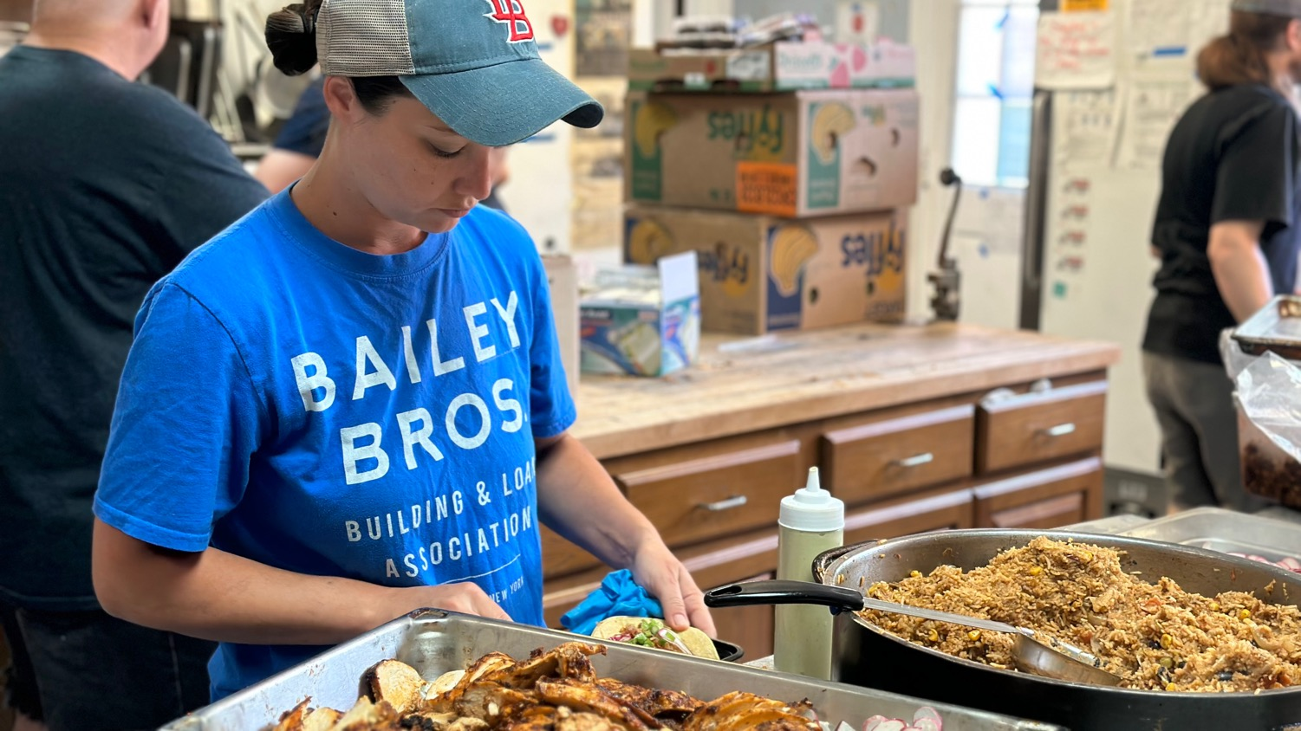

An intersection between hunger relief + food waste

Slide 2
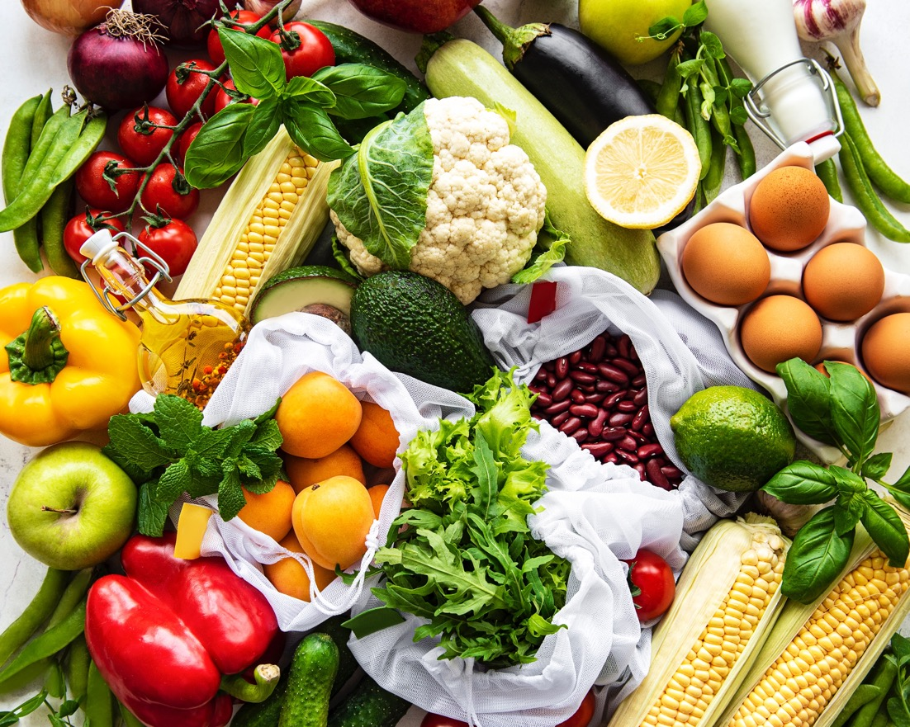
What we
know to be true
Hundreds of pounds of perfectly
good food goes into the landfill daily in Louisville.
Hundreds of people living in Louisville don’t know where their next meal is coming from.
30,000
people in the Louisville area are food insecure do not qualify for federal assistance
Notes:
https://greaterlouisvilleproject.org/food-security/

Slide 3
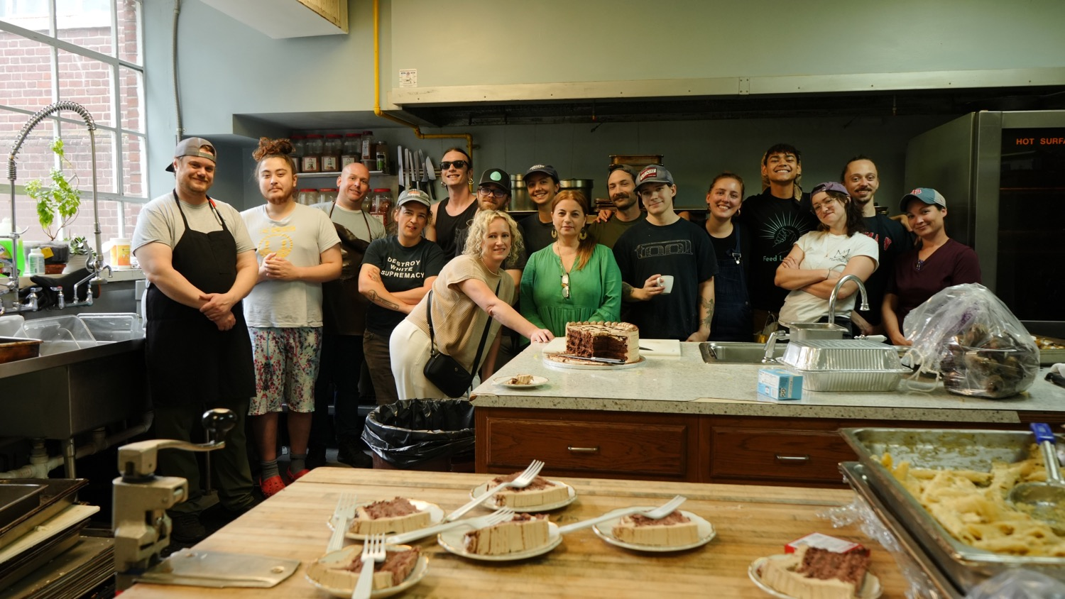
Our kitchen is the solution point
Notes:
Please put a photo of our new kitchen here

Slide 4
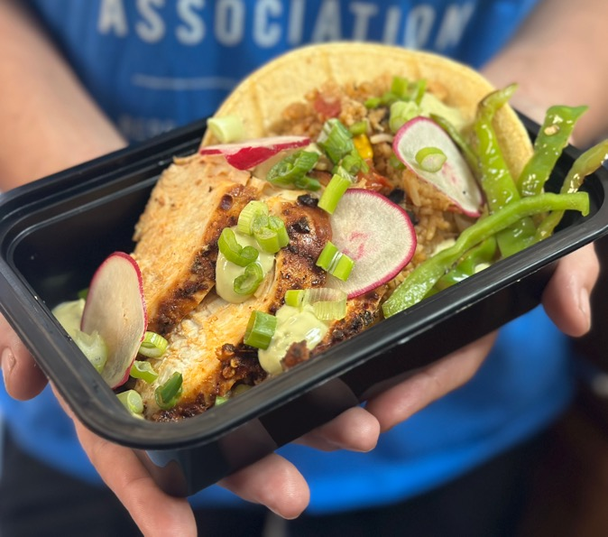
We have built the infrastructure that has allowed us to divert over 500,000 pounds of good food from going into the landfill and prepare over 400,000 beautiful meals in the past 4 years.
We have served over
400,000
beautiful meals in the past 4 years.

Slide 5
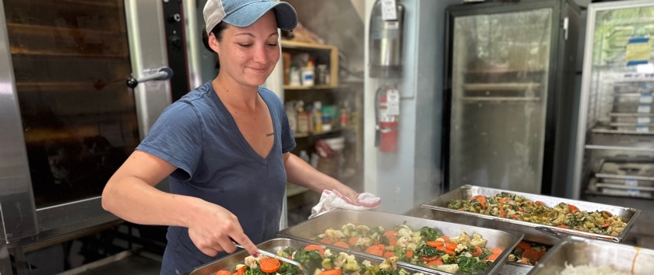
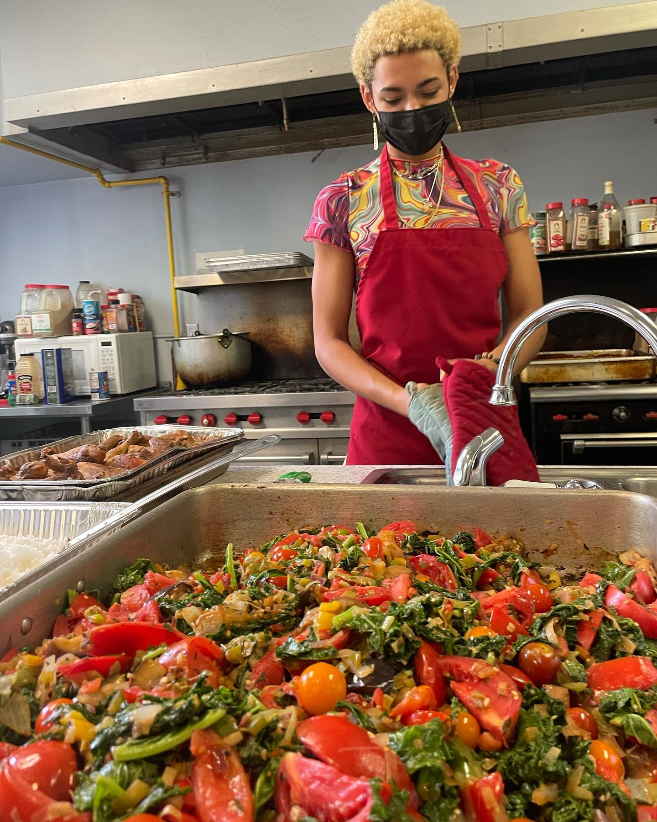
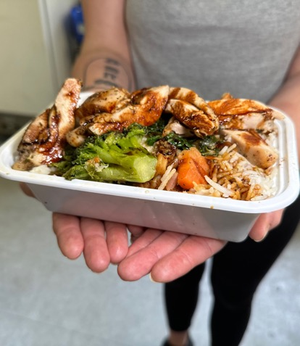
Who Are We?
We are a group of professional chefs who have worked in some of Louisville’s finest restaurants and now use our experience and passion to create beautiful meals for our unhoused and food insecure community

Slide 6
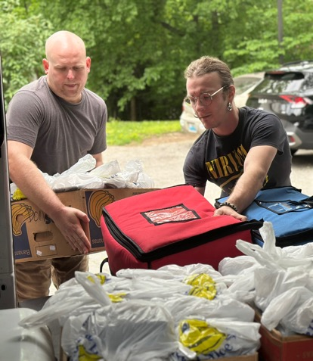
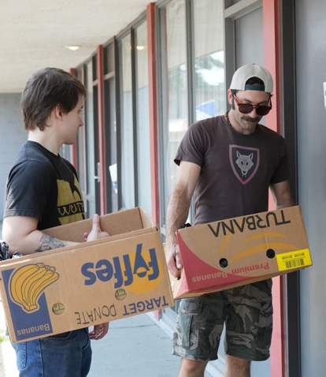

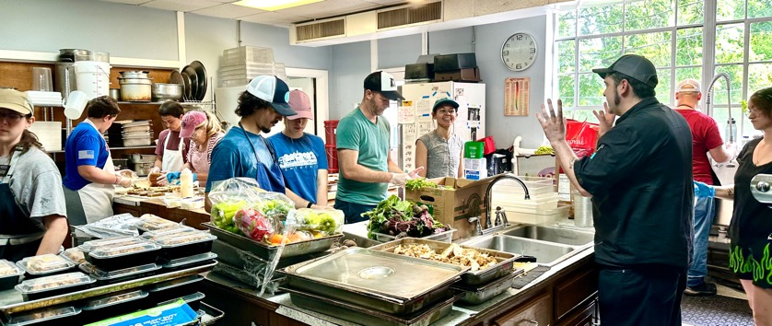
Who do we serve?
Every day we prepare 1,000 hot, nutritionally dense meals that our street outreach partners take directly to people staying in encampments and on the streets.
We are partnered with the Arthur Street Hotel, The Hope Village, Forgotten Louisville, Up for Women, Hope Garden and other front-line feeding organizations, who share our meals and food resources through their work with the unhoused community.

Slide 7
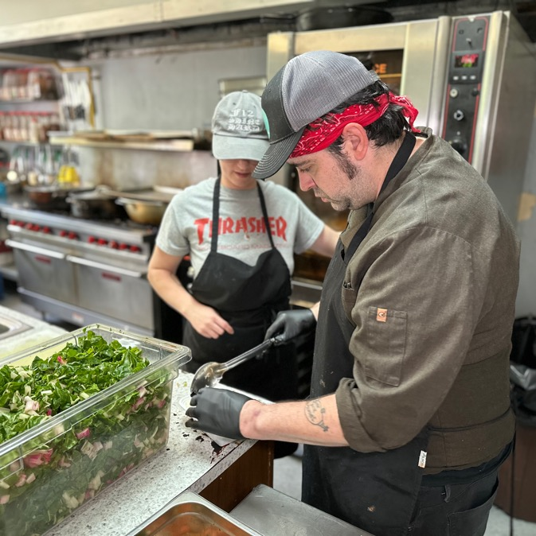
Why are chefs crucial
to this solution?
Professional chefs have the unique skills and passion that are critical to
the Food Rescue model
Every day we take in a wildly diverse array of prepared foods and raw ingredients. We have both the ability, and the drive, to re-envision those ingredients into hearty, culturally appropriate meals

Slide 8
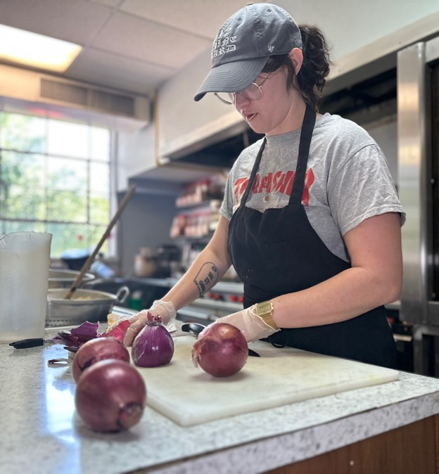
What is our process?
Just like an episode of Chopped, our chefs are challenged every day to make something great out of whatever is on hand. Every morning, we assess the prepared foods and raw ingredients that have come in the day before and go to work sketching out the menus for the day.
Our goal is to waste nothing.

Slide 9
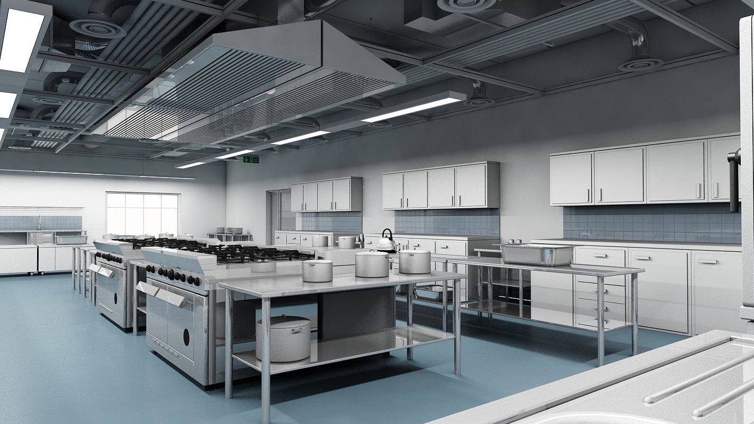

In our new 8,000 square foot kitchen we are able to:

Slide 10
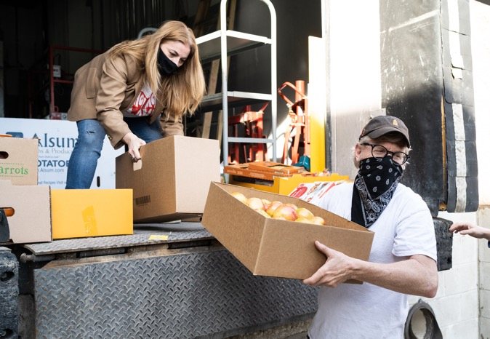
Rescue more food
We have only tapped into a small fraction of the food producers who need a place to donate their perfectly viable food.
We estimate that with this expanded production and storage space, we can increase our annual rescue of food to 1 million pounds.
We can take in
500,000
Pounds of food a year

Slide 11

















Our current food rescue partners
These are a few of our food rescue partners.
They are restaurants, caterers, bakers, food manufacturers and
growers who are relieved to have a place
to make good use of their overprepared food.

Slide 12
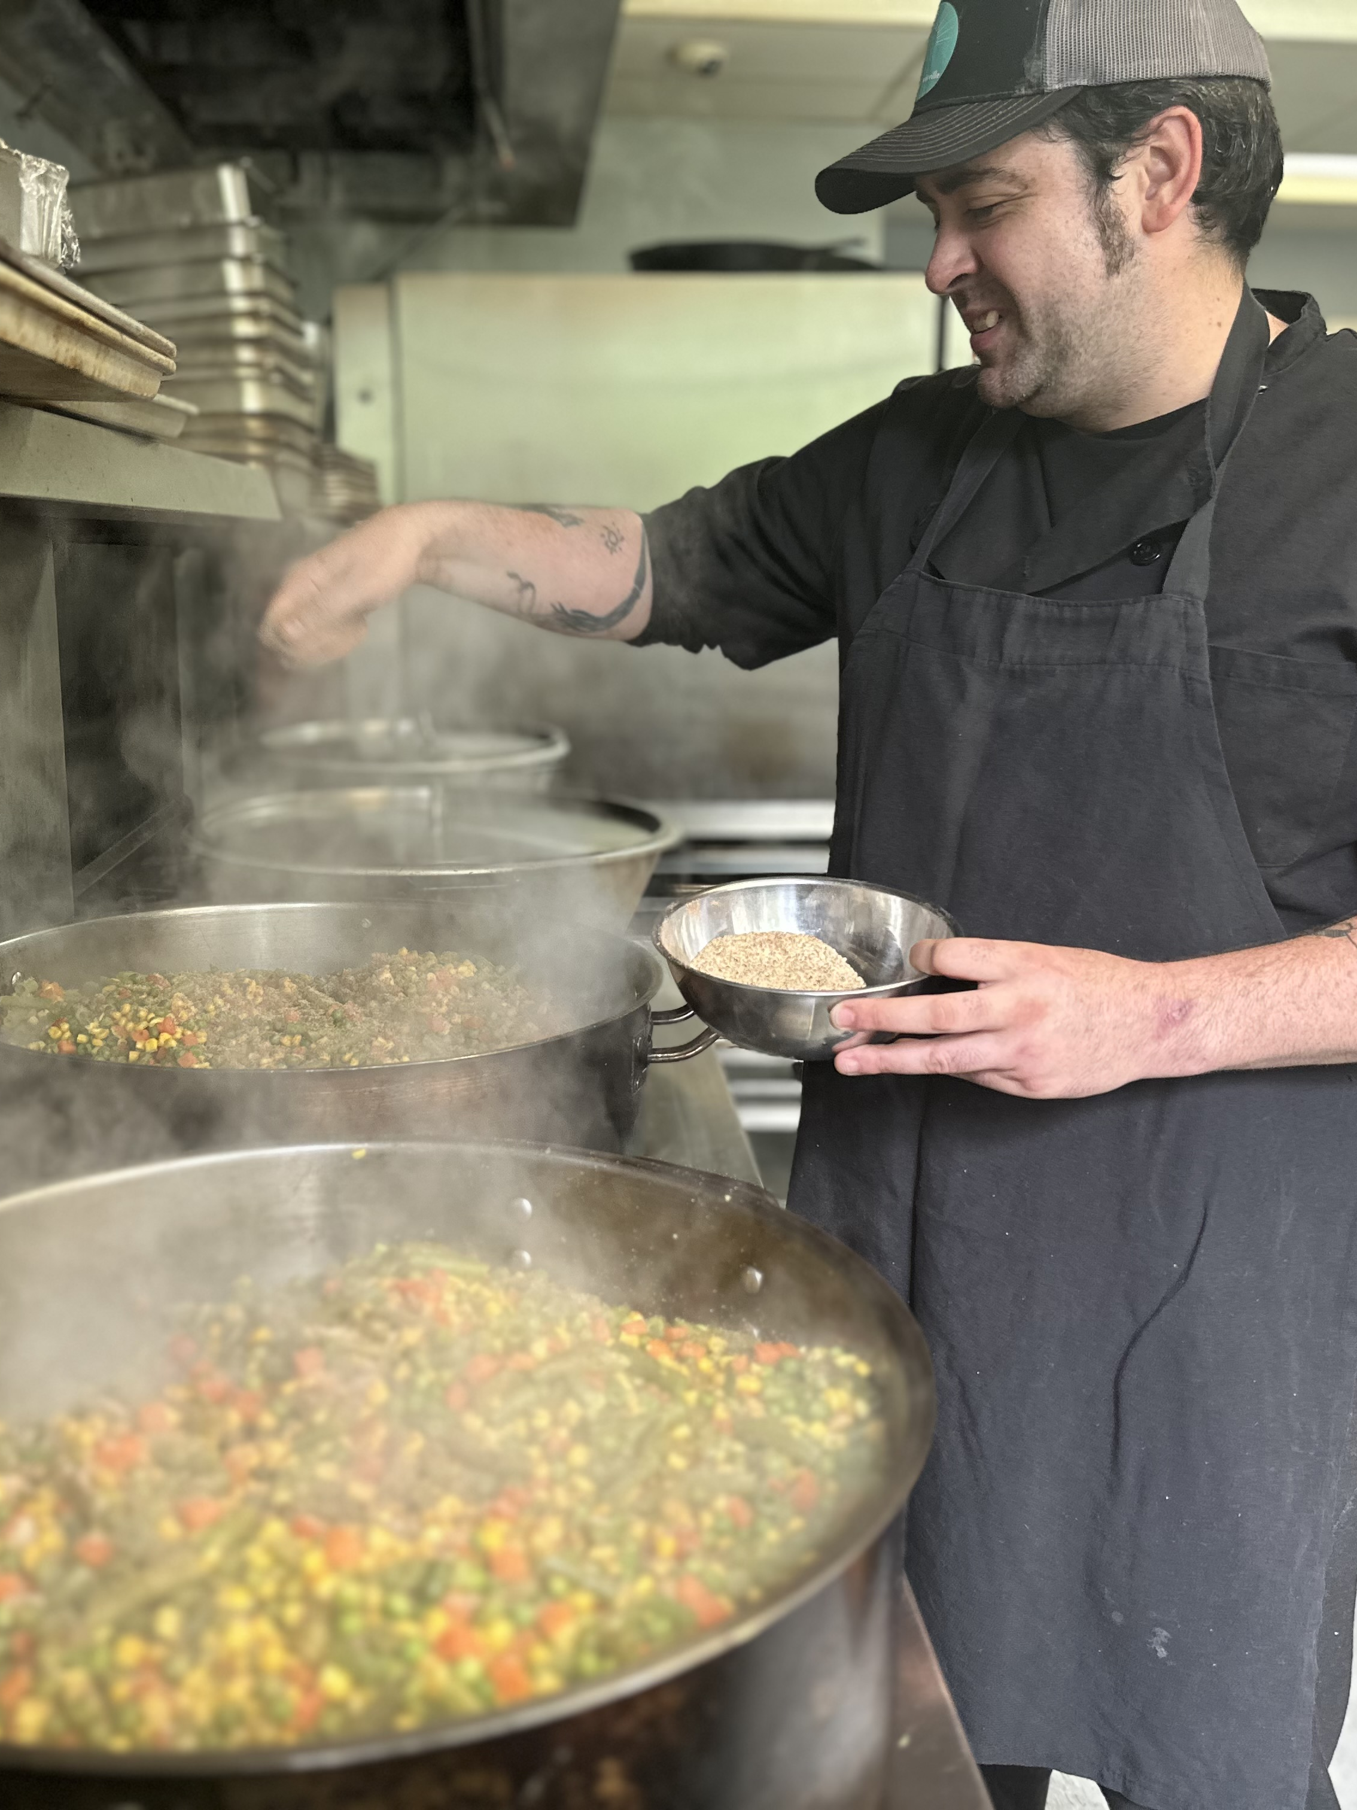
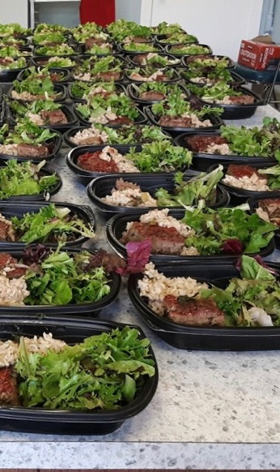
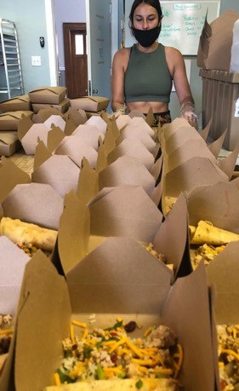
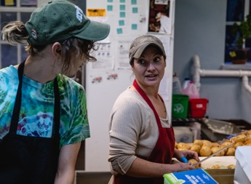
Feed more people
*
Prepare an additional two to five thousand meals a day
*
Expand the number of meals our own current partners can take out to the streets
*
Build partnerships with additional agencies who can get more food out to our houseless and food insecure communities

Slide 13









Our current community partners
In the past year we have expanded our partnerships with front-line feeding agencies
who take our meals directly to people experiencing hunger and homelessness.

Slide 14

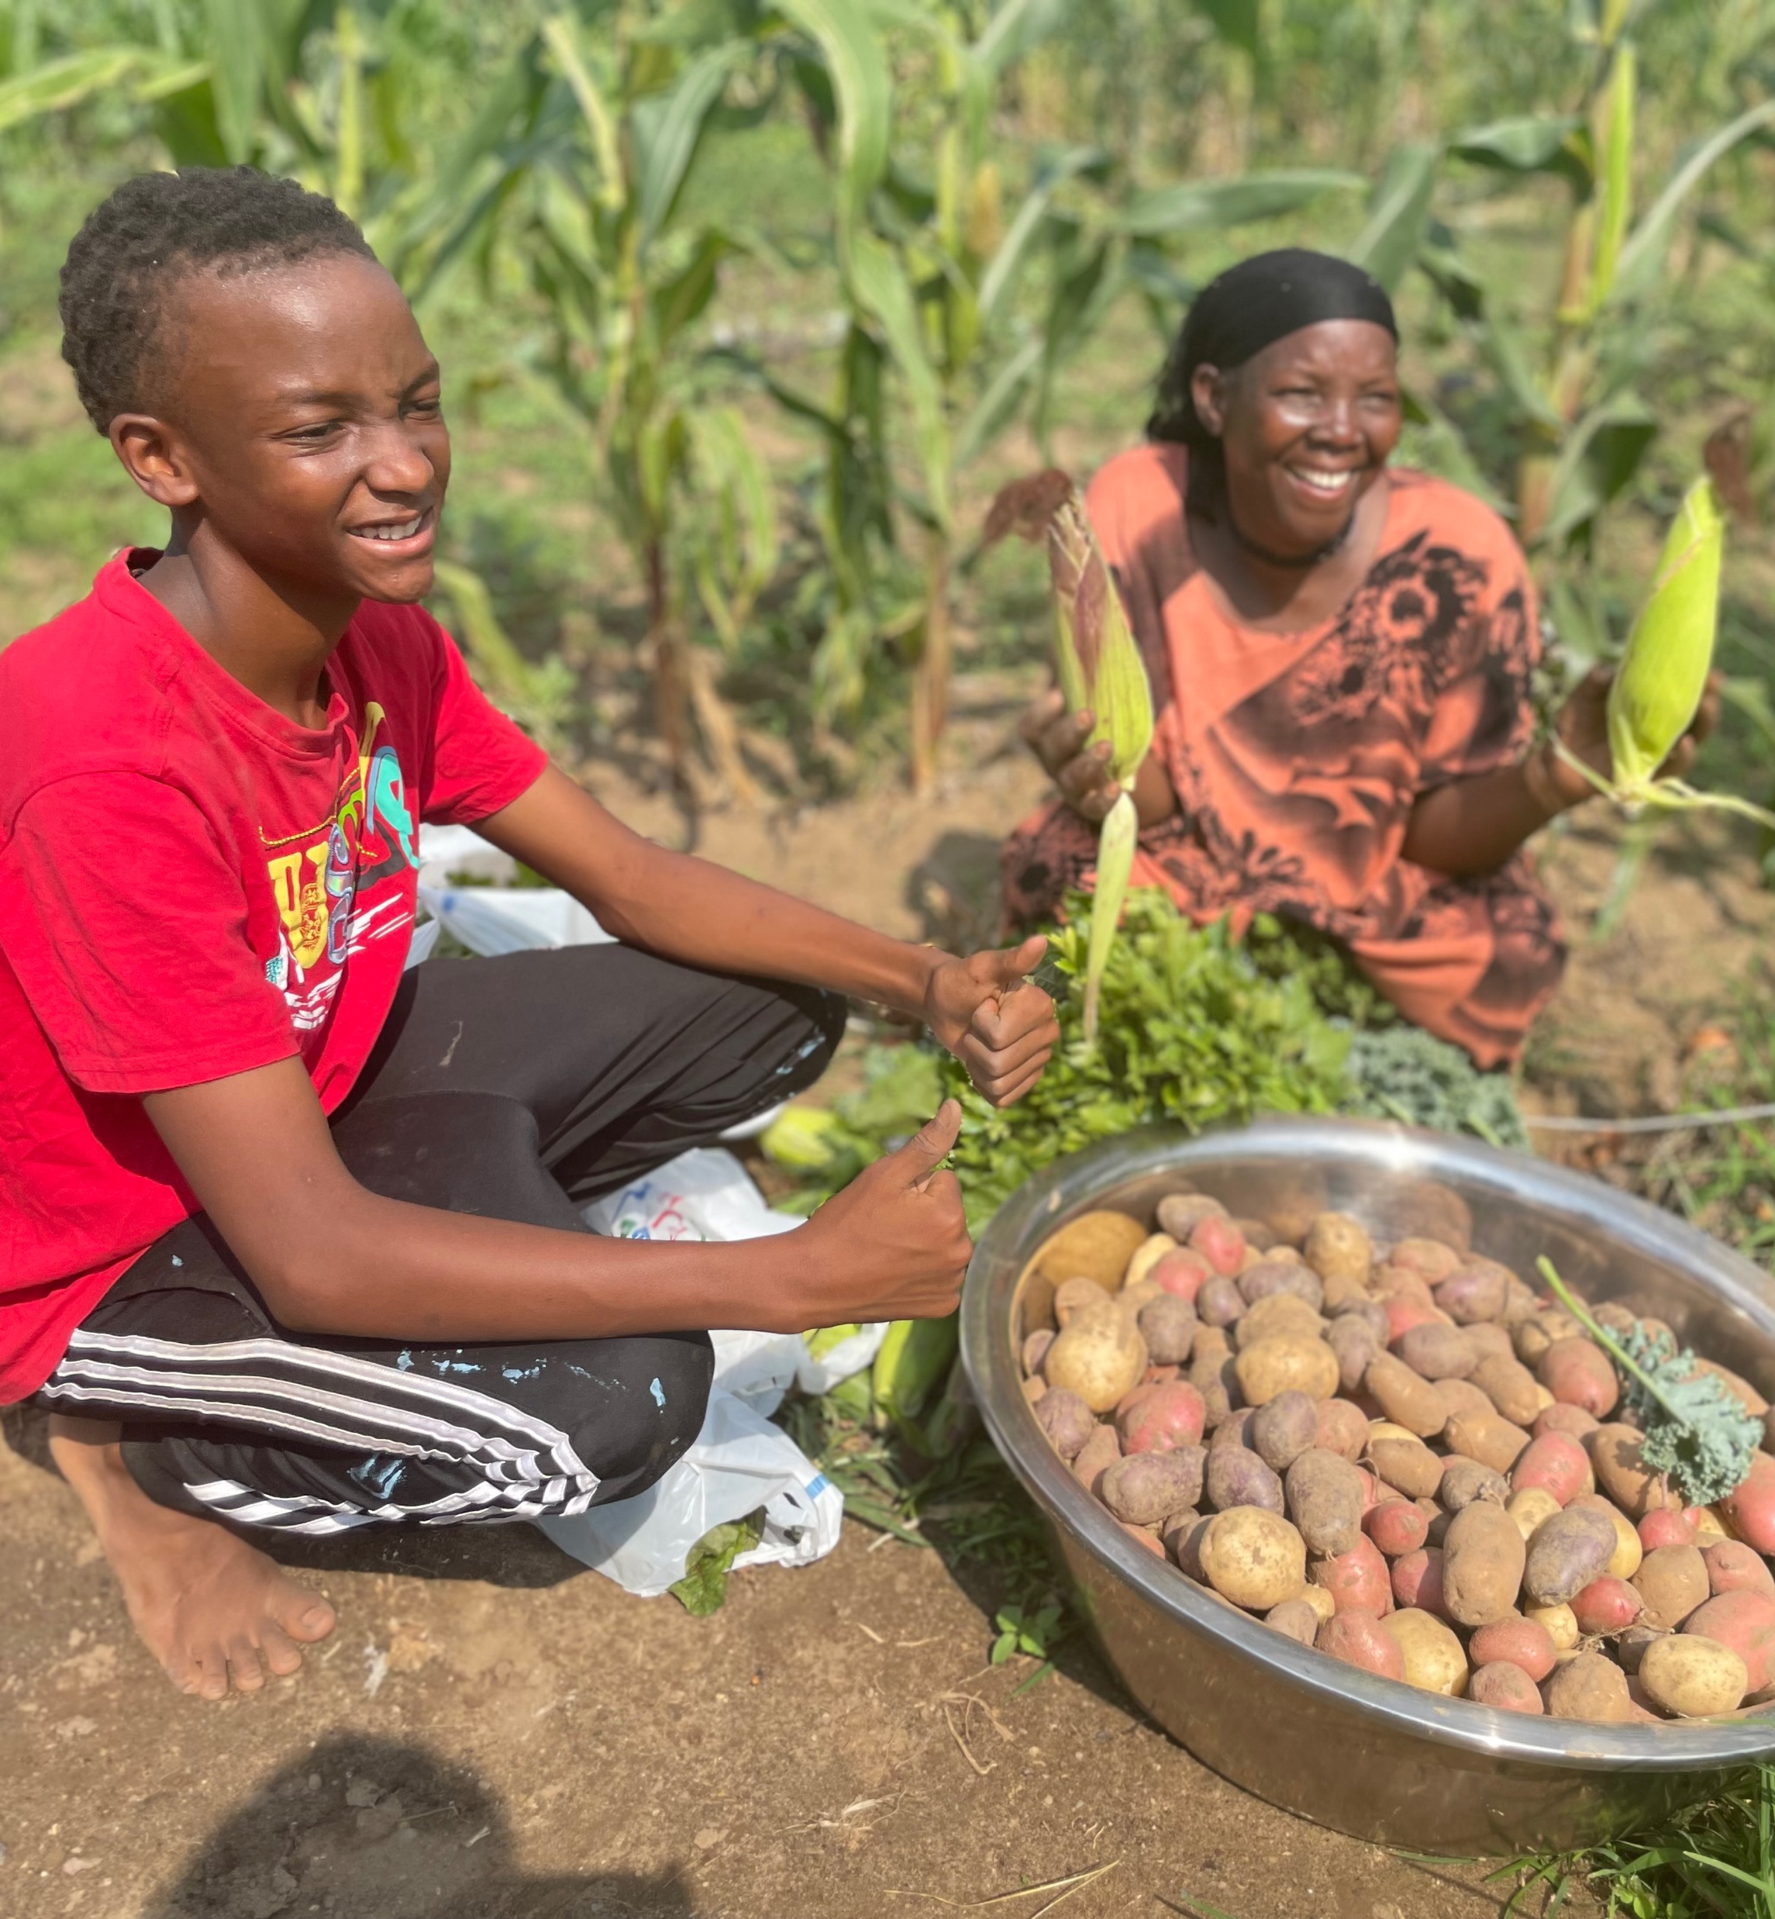
Strengthen our Farm Partnerships
*
We have multiple partnerships with local farmers who supply us with fresh produce and proteins regularly.
We highly value the role that local growers play in a healthy and just food system.
We want to do more to support them,
as their support of our work is critical.
*
*

Slide 15

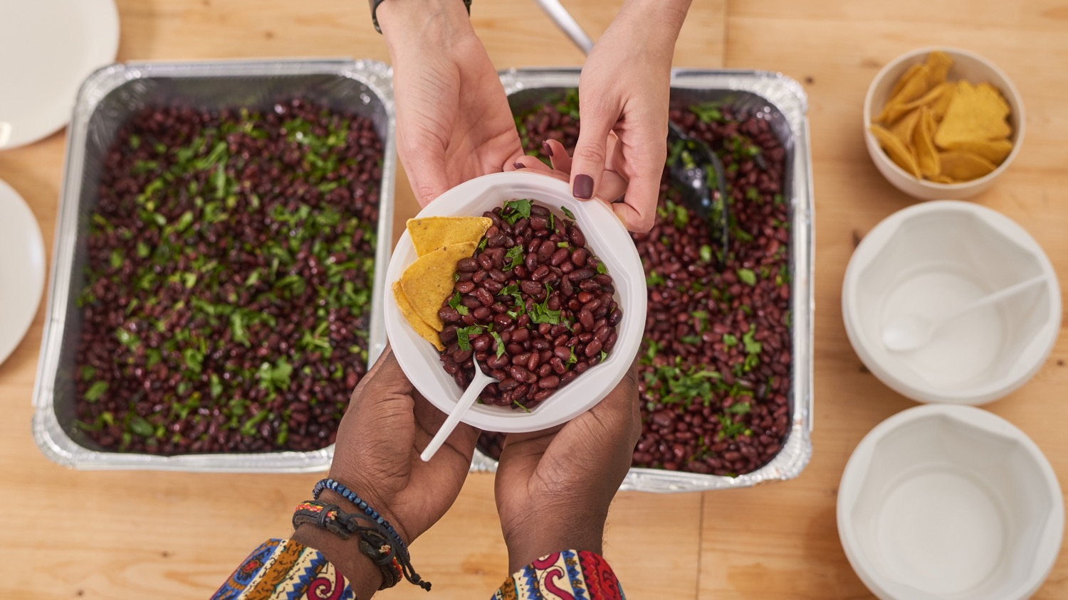

How can you help?
Scan here
www.feedlouisville.org
Follow us on Facebook & Instagram
@feedlouisville

